Slide 1
Logic Puzzle Tutorial!!!
An original logic puzzle, plus a step-by-step presentation showing how to fill out a puzzle. Let the fun begin!

Slide 2
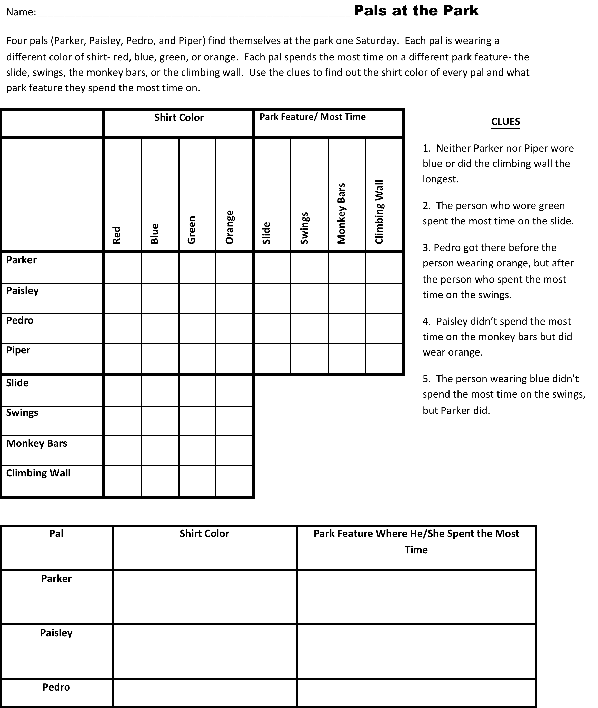

Slide 3
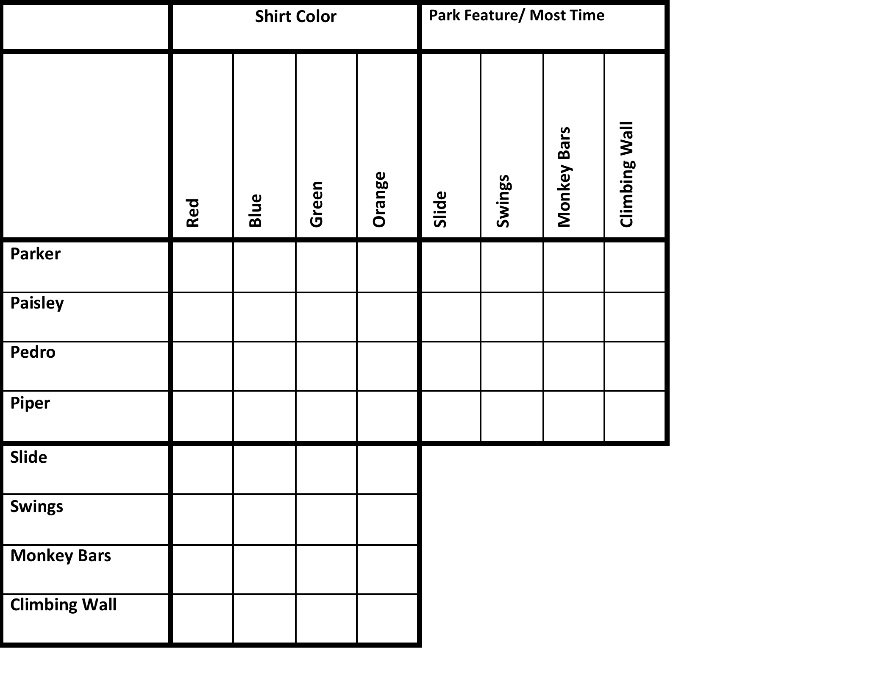
1.Neither Parker nor Piper wore blue or did the climbing wall the longest.
What do you know?
Parker didn’t wear blue or do the climbing wall most- X those boxes.
Piper didn’t wear blue or do the climbing wall- X those boxes.
X
X
X
X

Slide 4
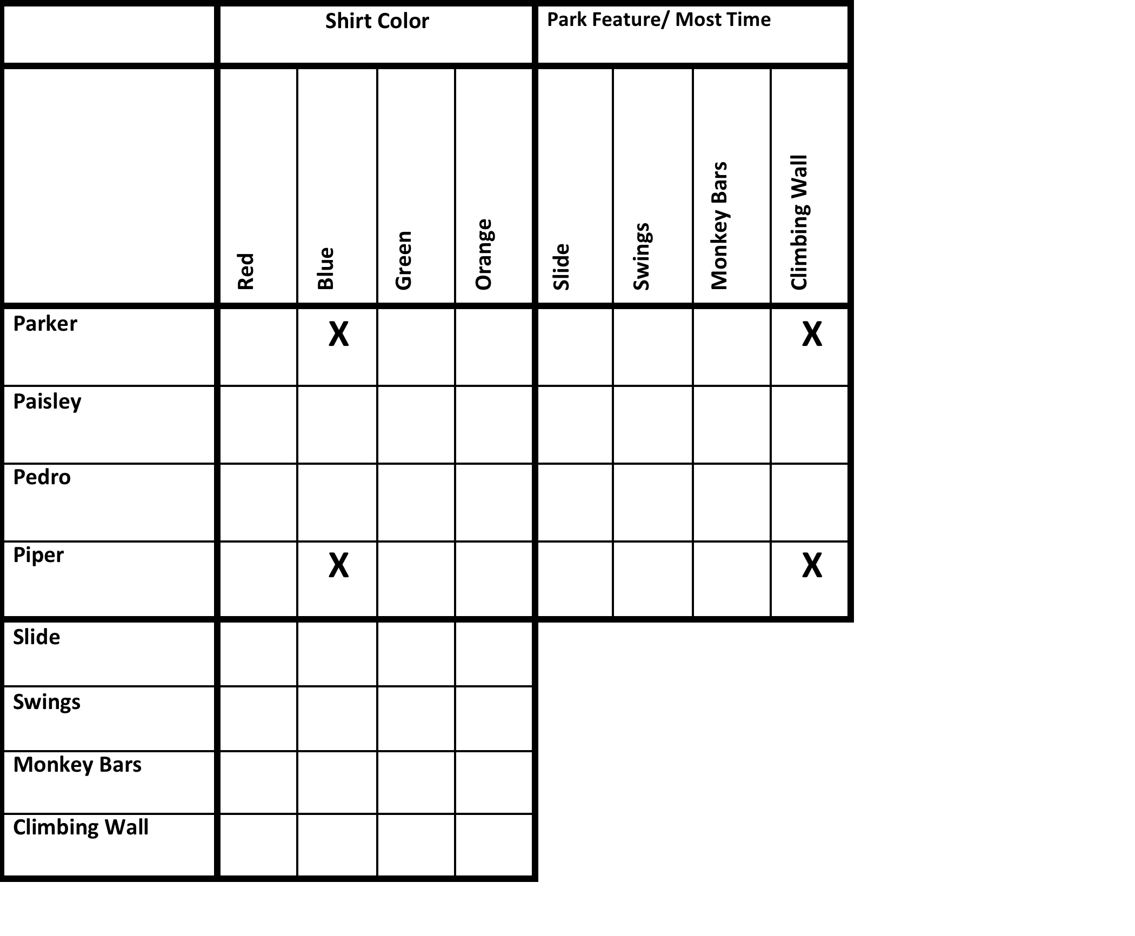
2. The person who wore green spent the most time on the slide.
What do you know?
The person who wore green was the only one who spent the most time on the slide.
Put an O in the green/ slide box.
Put X’s in that row and column- no other color spent the most time on the slide, and the person wearing green spent the most time only on the slide.
X
X
O
X
X
X
X

Slide 5
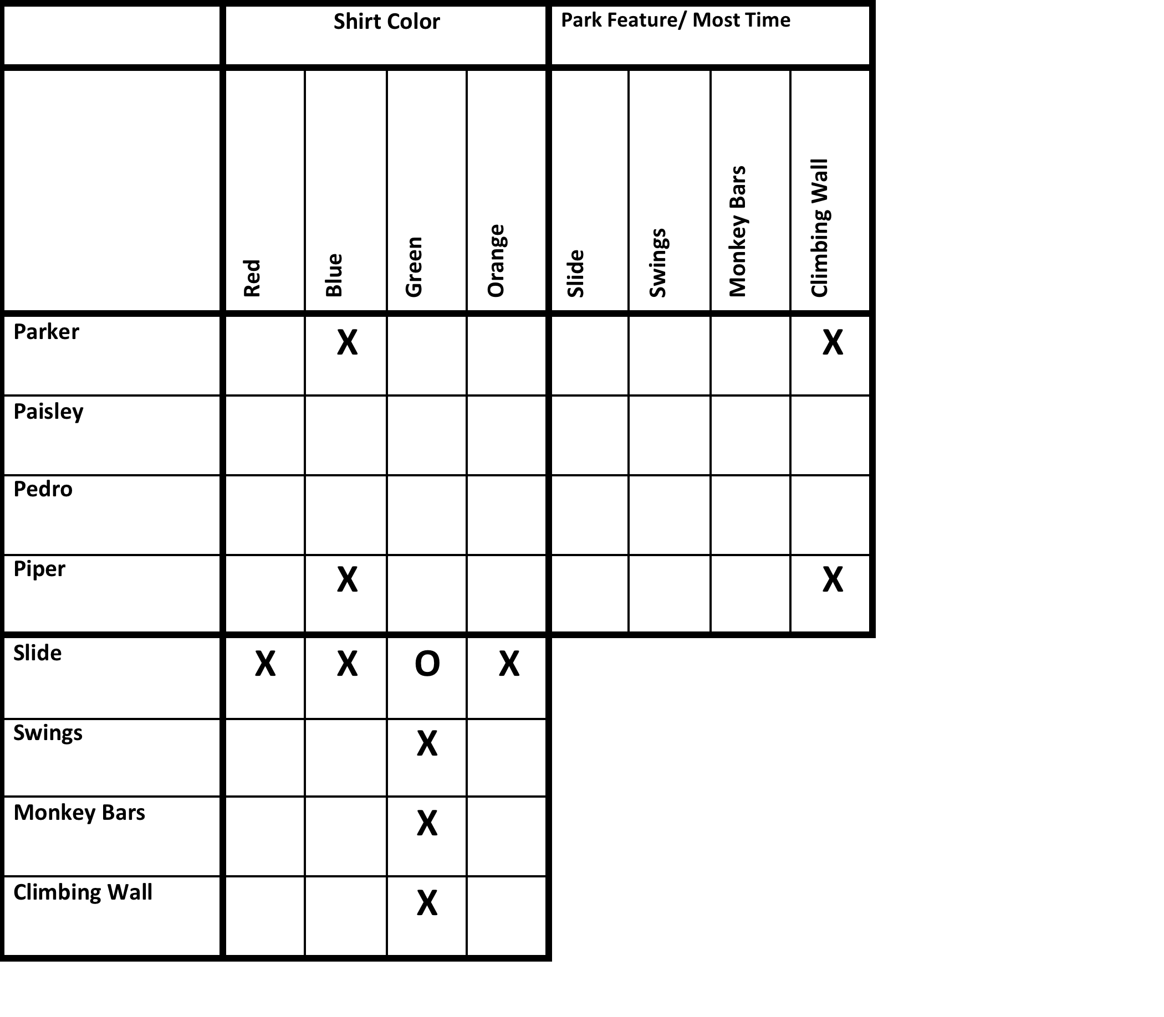
3. Pedro got there before the person wearing orange, but after the person who spent the most time on the swings.
What do you know?
Pedro wasn’t wearing orange. X the orange box for him.
Pedro didn’t spend the most time on the swings. X Pedro’s swings box.
The person wearing orange didn’t spend the most time on the swings. X the orange/ swings box.
X
X
X

Slide 6
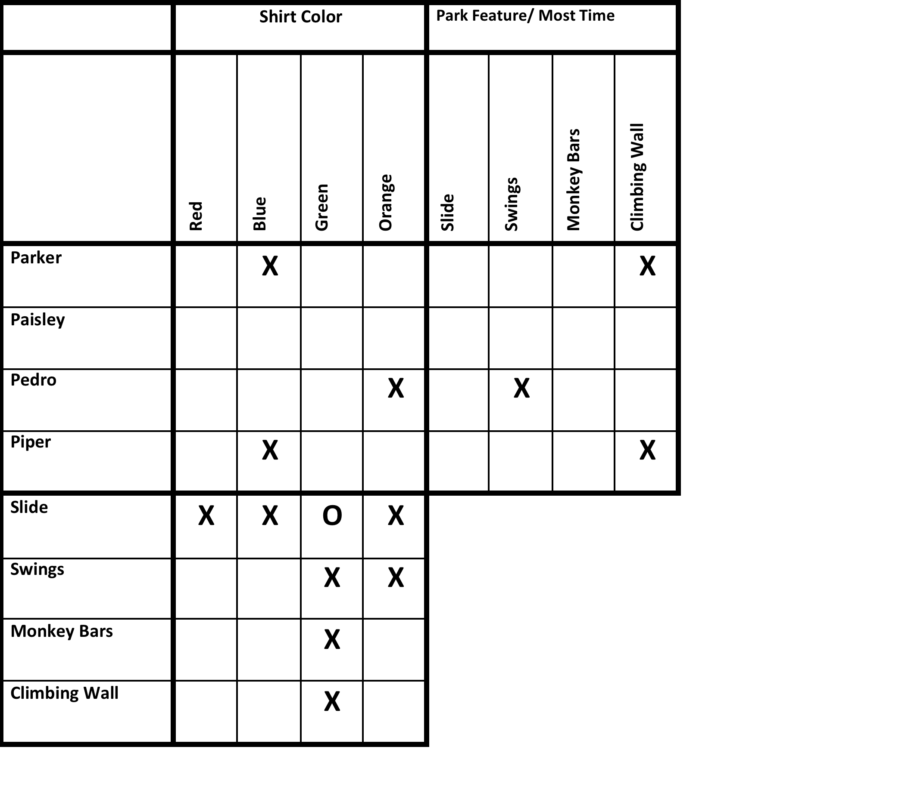
4. Paisley didn’t spend the most time on the monkey bars but did wear orange.
What do you know?
Paisley didn’t spend the most time on monkey bars- X that box.
She did wear orange- O that box, then X the rest of the boxes in that row and column. She didn’t wear any other color, and nobody else wore orange.
You can now see that the only color Pedro could’ve worn was blue. O that box, and fill in the row with X’s.
X
X
X
X
O
X
X
O
X
X

Slide 7
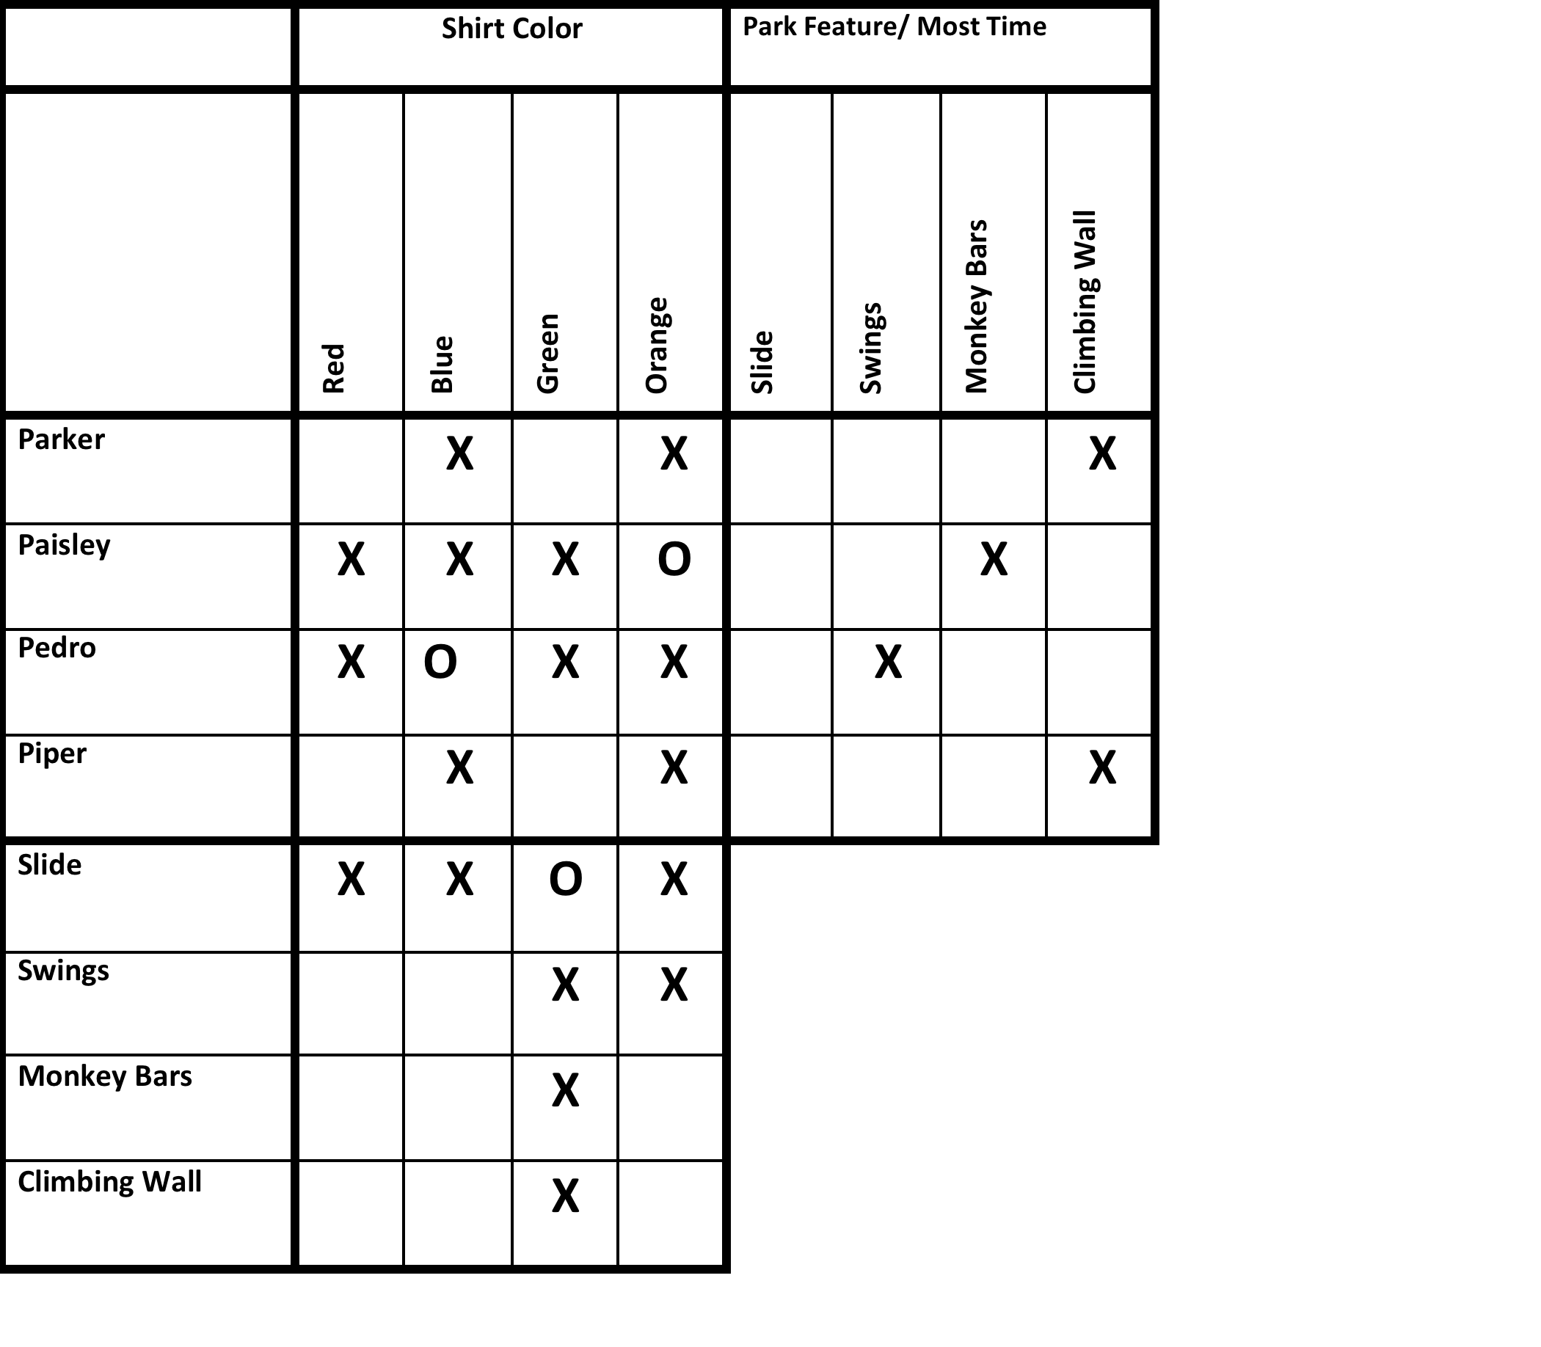
5. The person wearing blue didn’t spend the most time on the swings, but Parker did.
What do you know?
The person wearing blue (Pedro) didn’t spend the most time on the swings. There’s already an X there for Pedro, now mark an X under blue/ swings.
The person on the swings had to be wearing red. O that box, X out the rest of the column.
Parker spent the most time on the swings, so O that box and X the rest of the row and column.
X
O
X
X
X
O
X
X
X

Slide 8
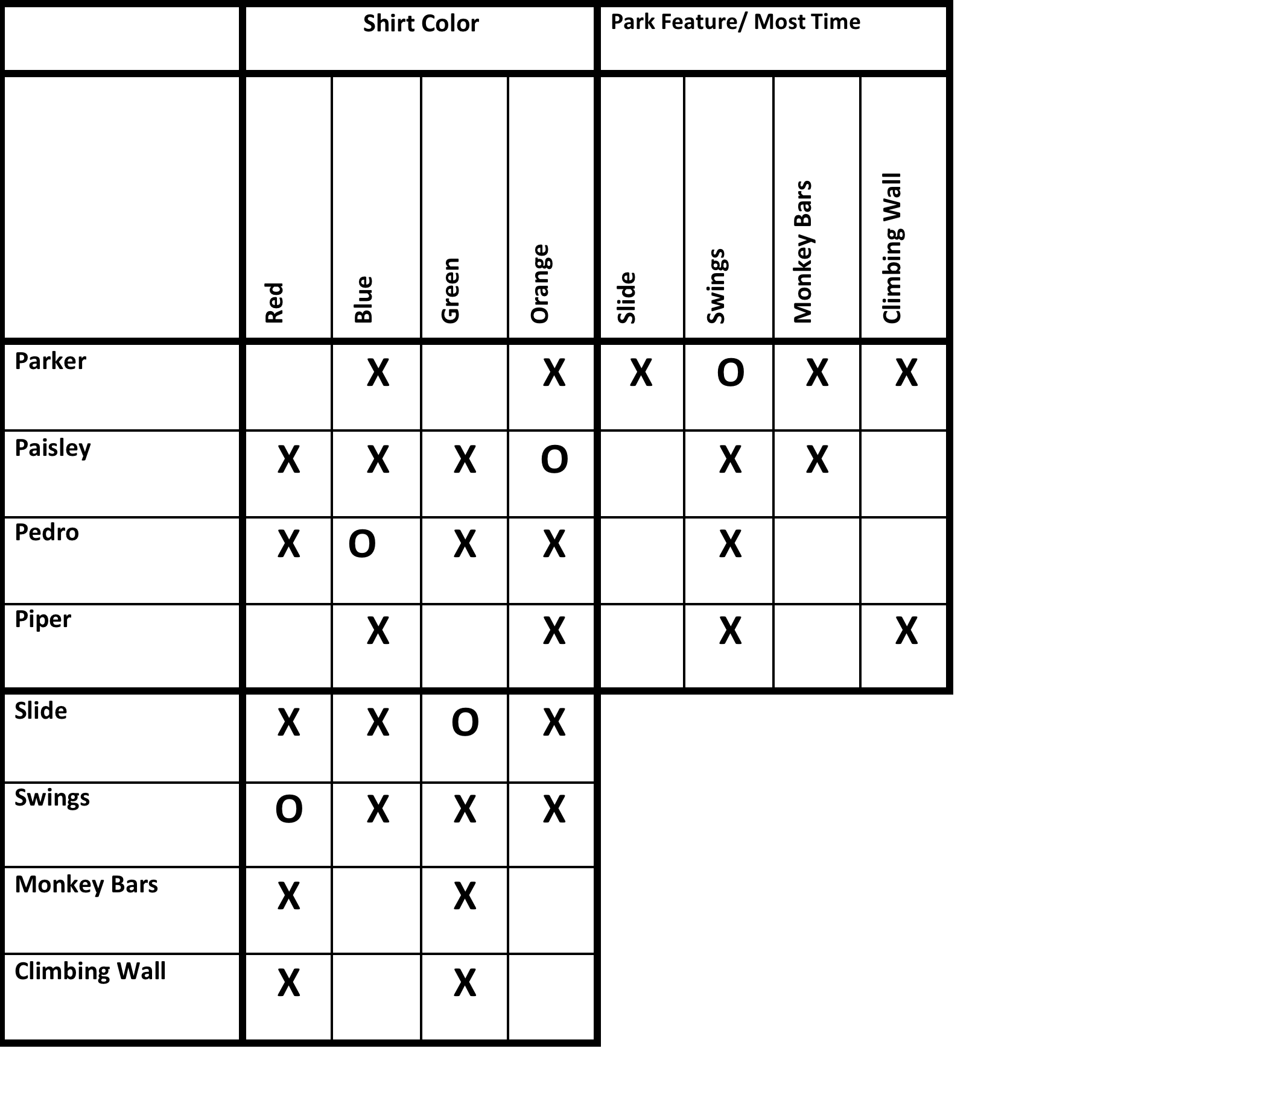
Now, compare what you have marked going across to what you have marked going down.
What do you know?
Parker played on the swings the most. The person who played most on the swings wore red, therefore, Parker wore red. Mark his box for red, and X out the others.
Now you can see that Piper had to be wearing green. O her box for green.
O
X
X
O

Slide 9
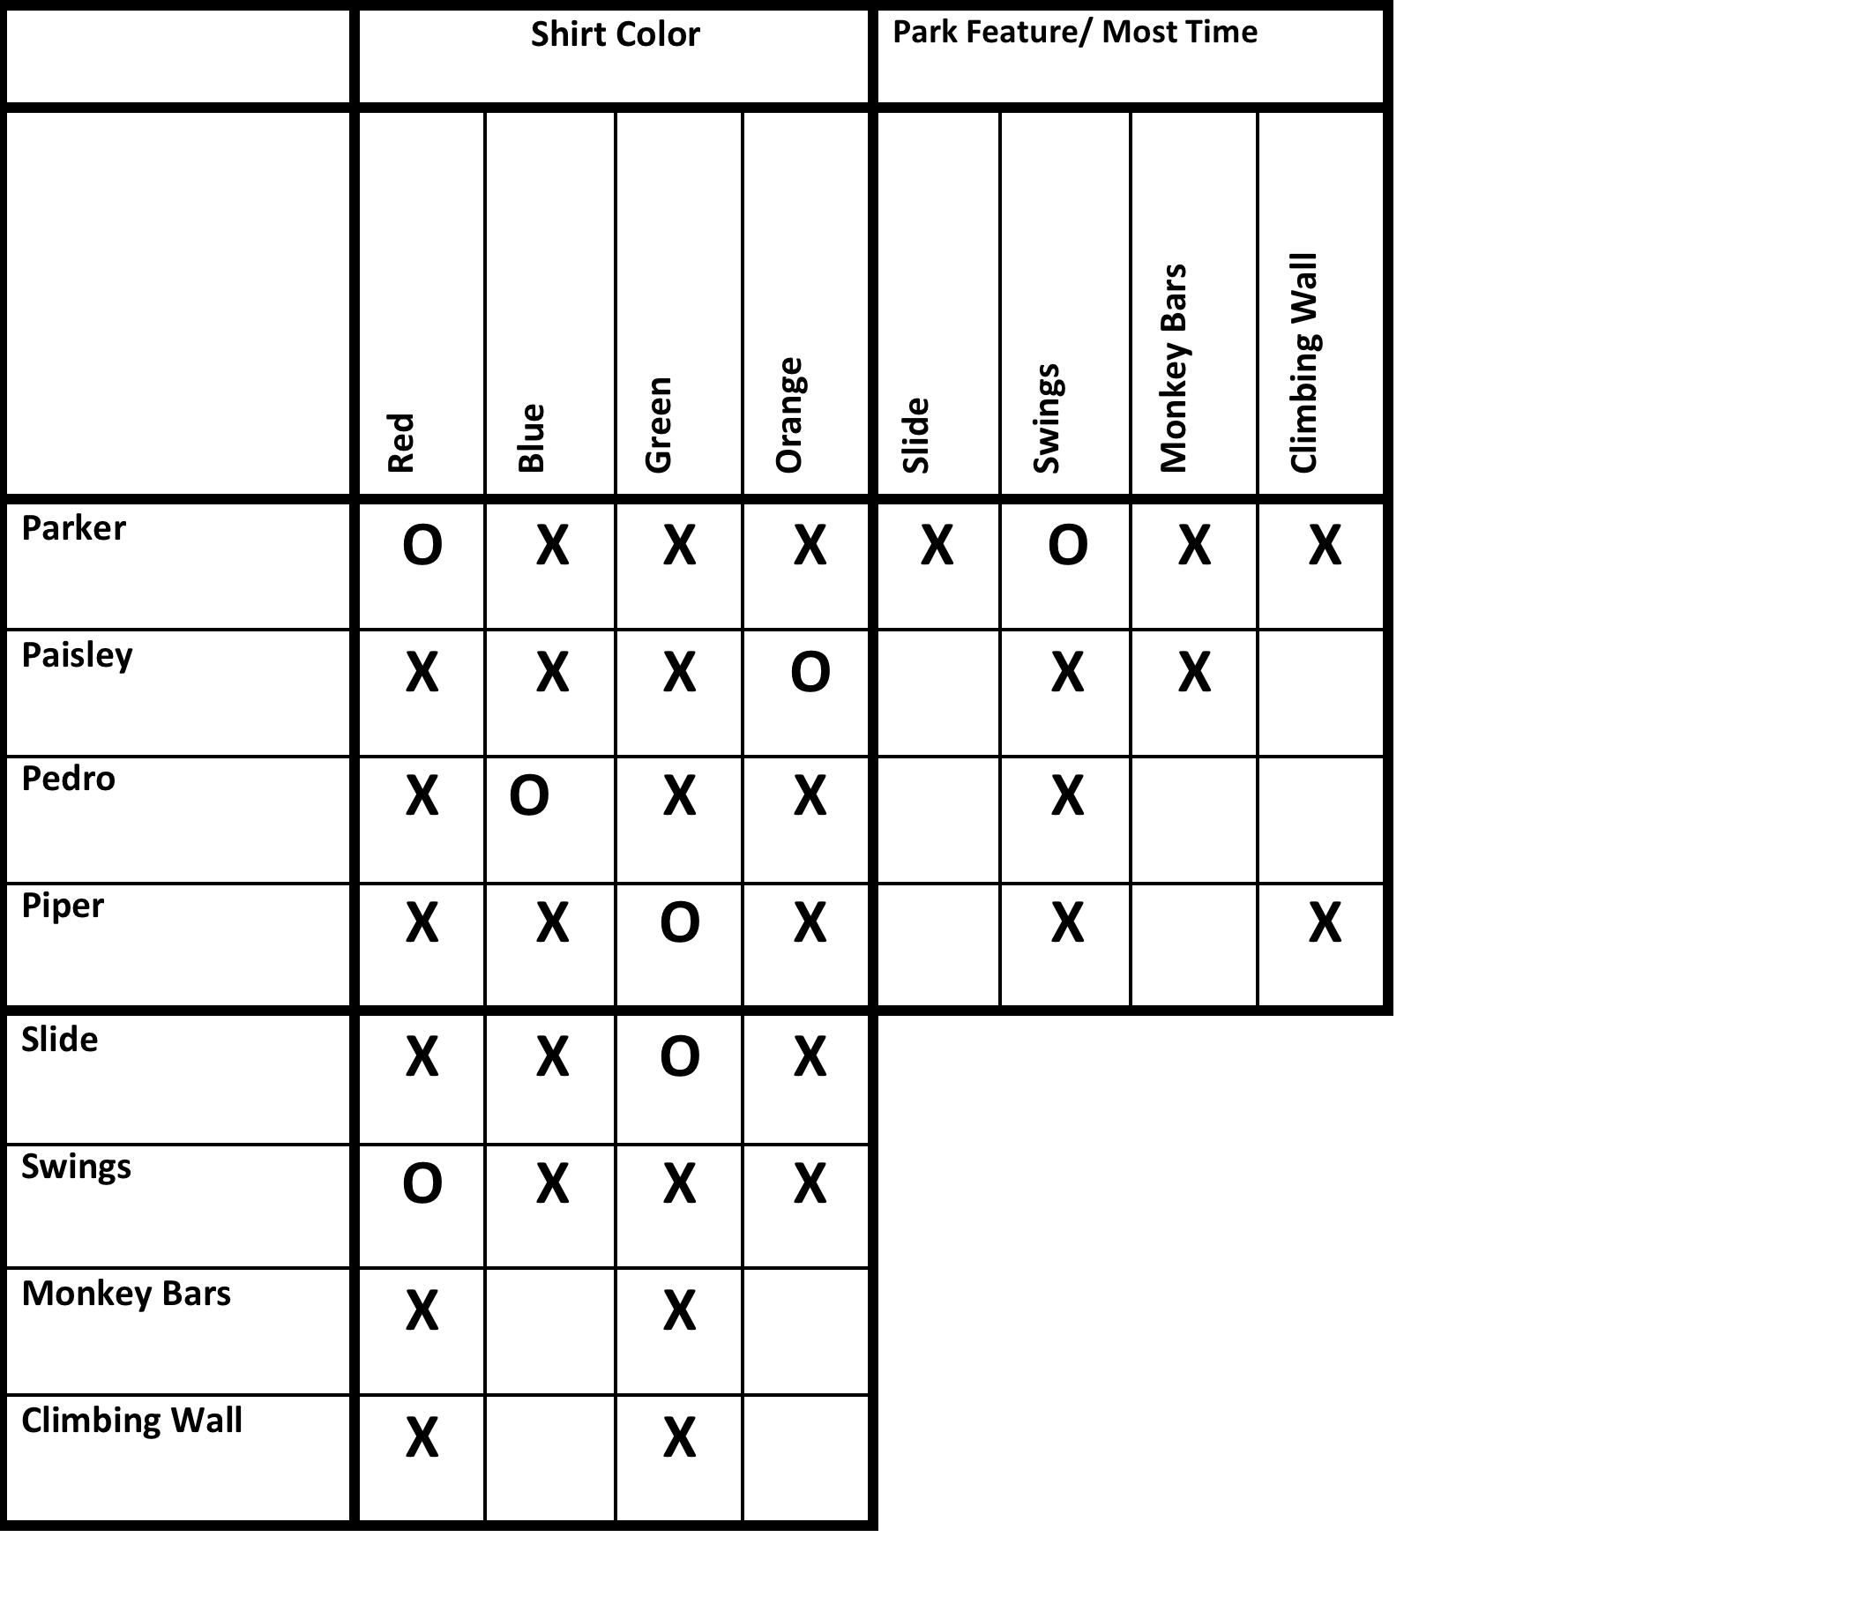
You now know everybody’s color. Check the bottom box to see what else you know.
What do you know?
The person on the slide wore green. That was Piper. Mark Piper’s box O for the slide. X out the rest of the row and column.
You can now see Paisley had to spend the most time on the climbing wall, and Pedro had to be on the monkey bars. O those boxes, and fill in the X’s .
X
O
X
O
X
O
X

Slide 10
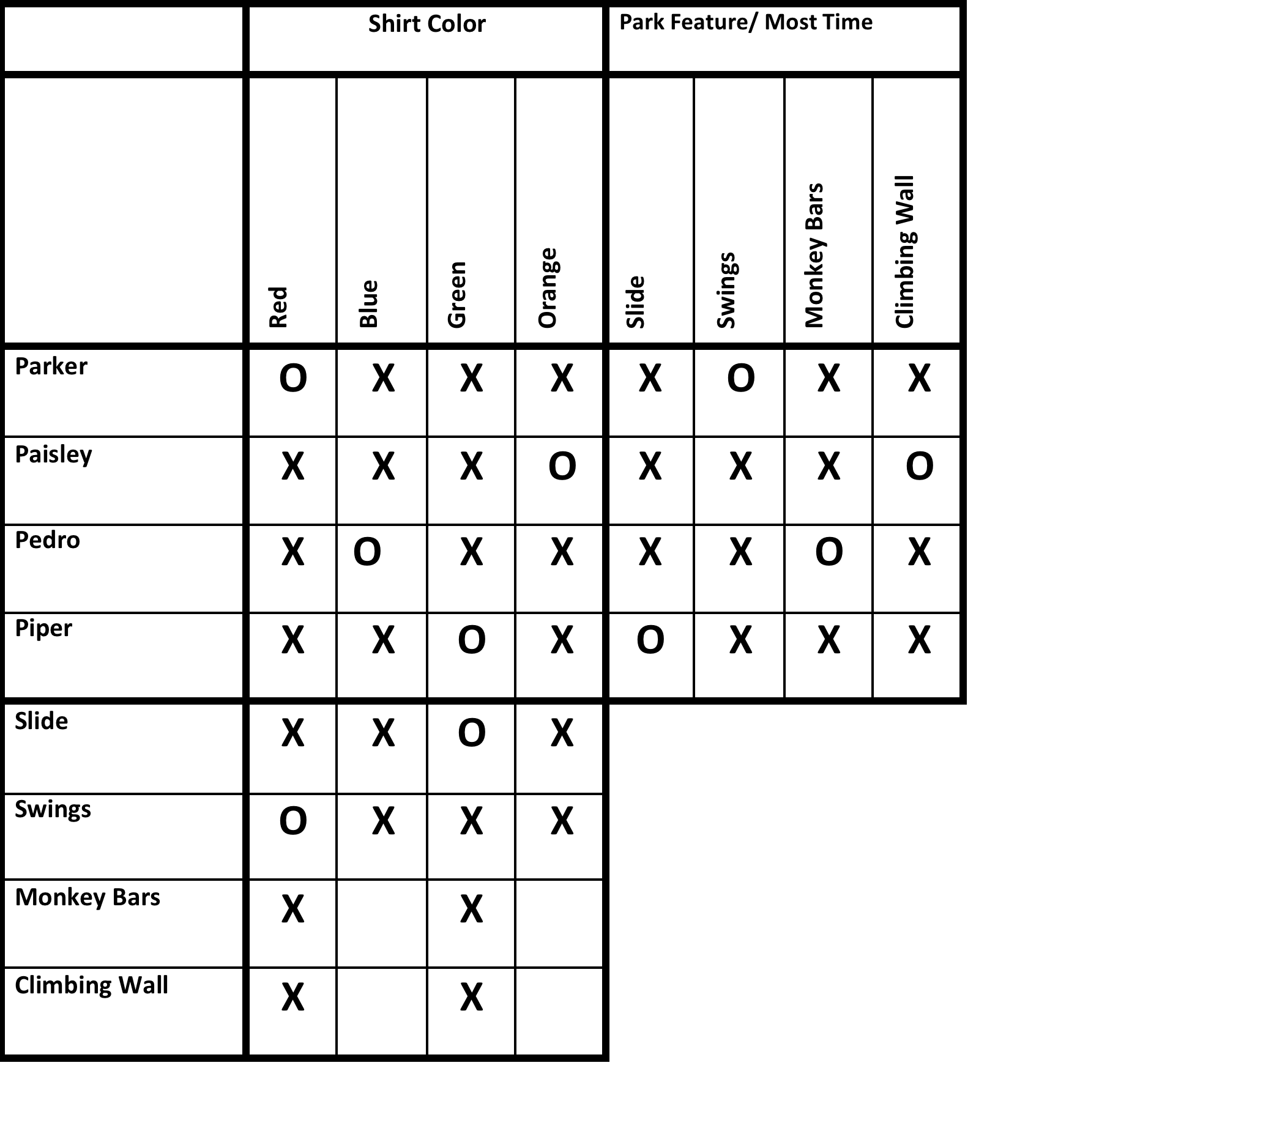
Now you just have to fill in the bottom box with the park feature played on most, using the colors to guide you.
What do you know?
Paisley was on the climbing wall most, and she wore orange. O that box.
Pedro was on the monkey bars most, and he wore blue. O that box.
Fill in the rest of the boxes with X’s.
O
X
X
O

Slide 11
Fill in the table with your answers.
Pal | Shirt Color | Park Feature
Parker | Red | Swings
Paisley | Orange | Climbing Wall
Pedro | Blue | Monkey Bars
Piper | Green | Slide
Now you’re ready to tackle the next logic puzzle on your own!

