Slide 1
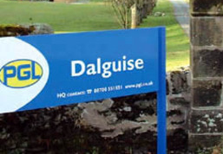
P7 ASG Camp Dalguise 2016 Parent Information
Tuesday 3rd May – Friday 6th May 2016

Slide 2
Lasswade ASG Transition Camp
Bonnyrigg Primary School
Burnbrae Primary School
Hawthornden Primary School
Lasswade Primary School
Loanhead Primary School
Rosewell Primary School
St Matthew’s Primary School

Slide 3
Why a transition camp?
Meet, work with and form new friendships with people who will be in their high school year group.
Team Building
Getting to know staff from Lasswade High School.
Demonstrating skills that are not always seen in a classroom setting.
Less anxiety for the transition from Primary to High School.

Slide 4
When do we go?
Leaving from school on Tuesday 3rd May
Returning to school Friday 6th May at lunchtime.

Slide 5
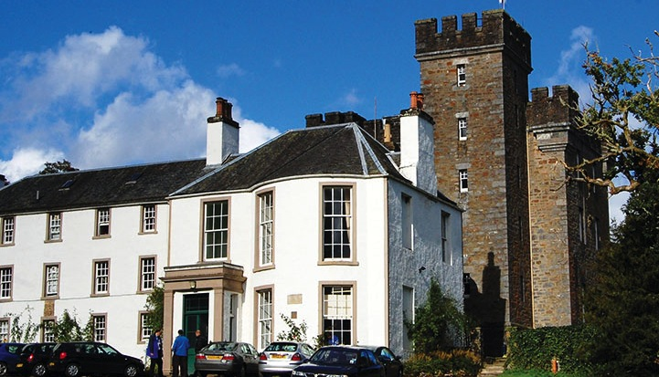
Dalguise Perthshire

Slide 6
Welcome to PGL
The UK’s largest provider of outdoor education for young people
Over 55 years’ experience
Fully risk assessed
LOtC Quality Badge holder
Founding member of BAPA
ABTA bonded
Notes:
PGL provides a wide range of inspiring residential adventure and educational courses for more than 5,000 groups every year
All PGL centres and activities are risk assessed to comply with legal requirements and best practice. Risk assessments are available by request and on the PGL website
Centres are subject to the Adventure Activities Licensing Authority regulations (AALA) where appropriate
ABTA (Association of British Travel Agents) bonded means your money is protected
BAPA – British Activity Providers Association. Responsible for establishing operating guidelines for the activity holiday industry
Through the Learning Outside the Classroom Quality Badge Programme you can be confident that recognised providers fulfil all the necessary criteria as laid down by the DfE, thereby better enabling Party Leaders to manage visits safely, efficiently and beneficially

Slide 7
LEARNING OUTSIDE
Dalguise - Perthshire
Stunning woodland location just 5 miles from Dunkeld
26 fantastic adventure activities to choose from
On-site lake and sports dome
Explore the 360 Virtual Tour www.pgl.co.uk/dalguise360 to see inside the centre and view activity information and videos

Slide 8
Accommodation
Lodges – en suite rooms sleep 4-6
The Stables – en suite rooms sleep 4-10
Accommodation for Dalguise can be viewed in the 360 virtual tour: www.pgl.co.uk/dalguise360
Notes:
The centre can accommodate 440 guests at a time with accommodation in our purpose-built woodland lodges or converted stable block
Teachers are usually accommodated in twin rooms with en suite and hot drink facilities
All rooms are lockable (party leader given master key)
All exterior doors and gates are locked at night but can be opened from the inside in an emergency without the need for unlocking
A PGL staff member is available on duty throughout the night (contactable by phone)
The extensive facilities (other than activity bases) are available to your group during free time

Slide 9
Daily Routine
7:30 – Wake Up and get dressed
8:00-9:00 – Breakfast Rota (In Schools)
9:00-10:30 – 1st Morning Activity
10:30-12:00 – 2nd Morning Activity
12:00-1:30 – Lunch Rota (In Schools)
1:30-2:00 – Organisation for Afternoon Activities.
2:00-3:30 – 1st Afternoon Activity
3:30-5:00 – 2nd Afternoon Activity
5:00-6:00 – Dinner Rota (In Schools)
6:00-7:00 – Free Time/Games
7:00-8:30 – Evening Entertainment
8:30-9:30 – Back to lodges/Bedtime

Slide 10
Adventure activities
Abseiling
Archery
Canoeing
Challenge Course
Climbing
Fencing
Giant Swing
Hiking
Nature Trail
Orienteering
Problem Solving
Sensory Trail
Sports and Team Games
Survivor
Trapeze
Tree Climb
Zip Wire
Notes:
The activities shown offer individual as well as team challenges.
Activities are designed to encourage new skills and develop existing ones.
Specific activities can be requested (though not guaranteed) and the programme is discussed on arrival at the centre.

Slide 11
Food At Camp?
All food is served in the dining room.
Breakfast: cereal, toast, cooked breakfast, fruit and yoghurt
Lunch: Selection of hot food, salad bar, bread and fruit
Dinner: Selection of hot food, salad bar, bread, fruit and dessert
Diluting juice/water
Allergies and food requirements catered for.
We will provide snack and supper for the children.
Sample menus available online: www.pgl.co.uk

Slide 12
Health & safety
The PGL Code of Practice describes all safety and operational procedures both on and off-site including:
Sample risk assessments
Staff-to-pupil ratios
Operating procedures
Staff vetting & training
Site security
First Aid procedures
Emergency procedures
www.pgl.co.uk/cop
Notes:
Please see Code of Practice for further detail
All centres and activities are fully risk assessed every year
The PGL Code of Practice details all the control measures put in place to minimise risk
Sample risk assessments are available on line and specific assessments are available from PGL on request
Staff-to-pupil ratios comply with recognised industry standards
Operating procedures all comply with recognised industry standards and National Governing Body guidelines where these are relevant
PGL recruitment officers have extensive experience at a senior level on centre and make selections based on a detailed application form
Two formal written references are taken and applicants have to provide documentary evidence of all qualifications claimed
All offers of employment are subject to DBS checks, the successful completion of pre-employment training and a favourable probationary period
All our instructors are specifically trained for our programmes to ensure the delivery of safe and rewarding sessions across a wide range of activities
At every PGL centre there is an experienced and professional Centre Manager (supported by Senior Staff) who is in charge of centre operations and has overall responsibility for the success of the course and the performance of our staff
It is the policy of PGL to take all reasonable steps to ensure the safety and security of all guests and staff on our centres (details in Code of Practice)
Each centre has at least two First Aid staff who hold the “First Aid at Work” qualification and in addition all our instructors and group leaders complete an 8 hour first aid course. Party Leaders and teachers will ultimately remain responsible for the administration of first aid to their party members
There are rigorous general accident and emergency procedures in place
Through the Quality Badge Programme you can be confident that recognised providers fulfil all the necessary criteria as laid down by the DfE, thereby better enabling Party Leaders to manage visits safely, efficiently and beneficially

Slide 13
Medicines/Needs
Medicines will be administered in lodges by school staff.
Medication that is needed throughout the day will be with the member of staff allocated to the child’s group.
Details of medication needed in a group will be included in a pack given to the staff member.
Each pack will be individual to that activity group.

Slide 14
Do’s & Don’ts
Do Not……
Bring electronic equipment.
Bring ANY food.
Bring hair-dryers or straighteners.
Bring aerosols.
Bring valuables or money.
Bring mobile phones.
Do…………..
Bring plenty of extra socks.
Bring a book/paper & pen for before bed.
Bring a black bag or plenty plastic bags to put wet/dirty clothes in.
Bring a waterproof jacket.
Have fun!

Slide 15
Pupil Expectations
All children attending the Lasswade ASG Camp must follow the behaviour expectations:
Respect all adults and each other
Respect all property (Safe use of windows)
Use paths to move around the grounds of Dalguise (Avoid walking/climbing on walls outside dorms)
Show good manners at all times
Only return to their own dormitories when instructed/supervised.
Consequences
If anyone fails to meet the expectations a clear warning will be given.
If the warning is not taken this will result in the child missing an activity and staying with Miss Stark or Mr Dougal
The HT of your child’s school will be contacted
If expectations are still not met a phone call will be made to you, and your child may be sent home.
The decision will be made by the HT of the school involved and Miss Stark and Mr Dougal

Slide 16
Keeping in Touch
If there is a situation where you need to get in touch with your child please contact Dalguise who will pass on the message to our staff.
If we need to get in touch with you we will do this using the emergency contact given or via your child’s school.
We will update our twitter feed as often as possible to keep you up to date with what is going on at camp!
You can follow us at @lasswadecamp

Slide 17
Thank you for listening
Any questions?
Notes:
Questions?

